Slide 1
Development of the Multiple Operating System
Guide :Prof. P. M. Kanjalkar
A Project by-
Class- SY-IC Div- A
Team Members-
69. Jaydeep Jadhav(11911047)
70. Mitali Jadhav(11911071)
71. Rutuja Jamdar(11910227)
73. Saurabh Jejurkar(11910324)

Slide 2
Content
Introduction
Instructions
Problem Statement
Requirements
Assumption
Notation
Job writing
Program execution
conclusion

Slide 3
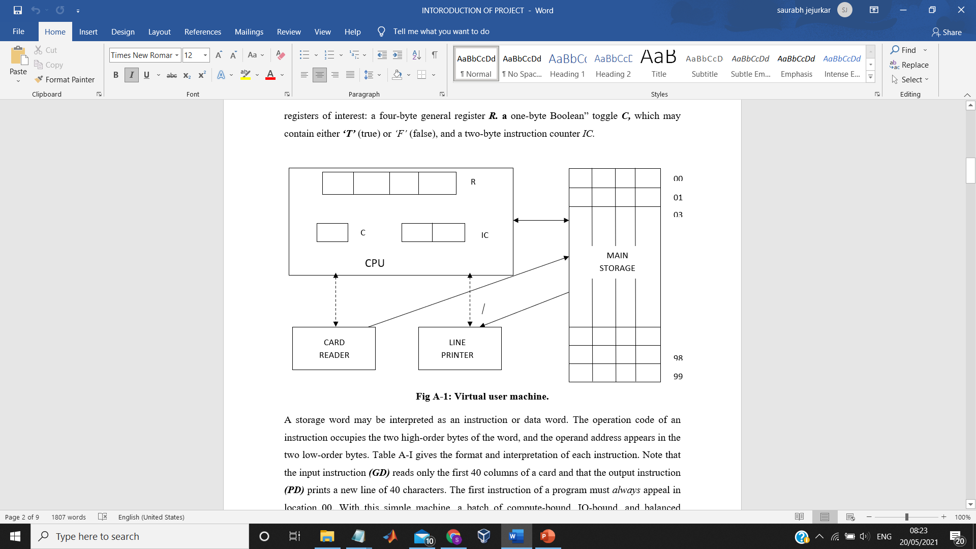
Introduction

Slide 4
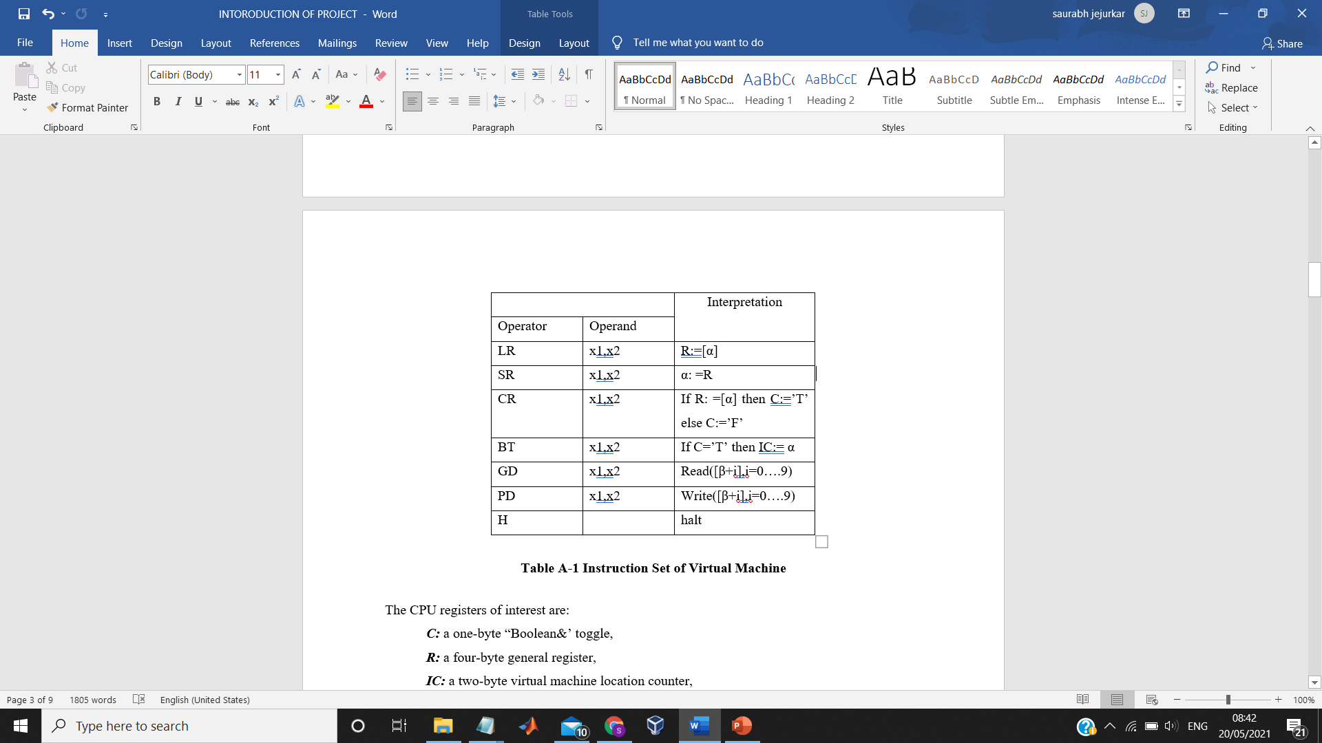
Instructions

Slide 5
Problem Statement
i. CPU/ Machine Simulation
ii. Supervisor Call through interrupt

Slide 6
Requirements
Software: Visual Studio Code
Input: Job file

Slide 7
Assumption
Jobs entered without error in input file
No physical separation between jobs
Job outputs separated in output file by 2 blank lines
Program loaded in memory starting at location 00
No multiprogramming, load and run one program at a time
SI interrupt for service request

Slide 8
Notation
M: memory; IR: Instruction Register (4 bytes)
IR [1, 2]: Bytes 1, 2 of IR/Operation Code
IR [3, 4]: Bytes 3, 4 of IR/Operand Address
M[&]: Content of memory location &
IC: Instruction Counter Register (2 bytes)
R: General Purpose Register (4 bytes)
C: Toggle (1 byte)
: Loaded/stored/placed into

Slide 9
Job writing
A user job is submitted as a deck of control, program, and data cards in the order:
<JOB card>, <Program>, <DATA card>, <Data>, <ENDJOB card>.
1. The <JOB cord>contains four entries:
(1) $AMJ cc. 1-4, A Multiprogramming Job
(2) <job Id>cc. 5—8, a unique 4-character job identifier.
(3) <time estimate>cc. 9—12, 4-digit maximum time estimate.
(4) <line estimate>cc. 13—16, 4-digit maximum output estimate.

Slide 10
Job writing
2. Each card of the <Program>deck contains information in card columns1-40. The i^{th}card contains the initial contents of user virtual memory locations.
l0(i - 1), 10(I - 1) + 1,. .., 10(I - 1) + 9, i = 1, 2…. n,
Where n is the number of cards in the <Program>deck. Each word may contain a VMinstruction or four bytes of data. The number of cards n in the program deck defines the sizeof the user space; i.e., n cards define 10 X n words, n 10.
3. The <DATA card>has the format: The (Data) deck contains information in cc. 1—40 and is the user data retrieved by theVM GD instructions.
5. The (JOB card) has the format:SEND cc. 1-4
<job Id>cc. 5—8, same <job Id) as <JOB card>
The <DATA card>is omitted if there are no <Data>cards in a job.

Slide 11
Program Execution
MOS (MASTER MODE)
SI = 3 (Initialization)
Case SI of
1: Read
2: Write
3: Terminate
Endcase
READ:
IR [4] ← 0
Read next (data) card from input file in memory locations IR [3,4] through IR [3,4] +9
If M [IR [3,4]] = $END, abort (out-of-data)
EXECUTEUSERPROGRAM
WRITE:
IR [4] ← 0
Write one block (10 words of memory) from memory locations IR [3,4] through IR [3,4] + 9 to output file
EXECUTEUSERPROGRAM

Slide 12
Program Execution
TERMINATE:
Write 2 blank lines in output file
MOS/LOAD
LOAD:
m ← 0
While not e-o-f
Read next (program or control) card from input file in a buffer
Control card: $AMJ, end-while
$DTA, MOS/STARTEXECUTION
$END, end-while
Program Card: If m = 100, abort (memory exceeded)
Store buffer in memory locations m through m + 9
m ← m + 10
End-While
STOP

Slide 13
Project Timeline
Program Execution
MOS/STARTEXECUTION
IC ← 00
EXECUTEUSERPROGRAM
EXECUTEUSERPROGRAM (SLAVE MODE)
Loop
IR ← M [IC]
IC ← IC+1
Examine IR[1,2]
LR: R ← M [IR[3,4]]
SR: R → M [IR[3,4]]
CR: Compare R and M [IR[3,4]]
If equal C ← T else C ← F
BT: If C = T then IC ← IR [3,4]
GD: SI = 1
PD: SI = 2
H: SI = 3
End-Examine
End-Loop

Slide 14
Conclusion
Understand all general concept of Multiprogramming Operating System.
Understand How to write assembly program to execute on multiprogramming operating system.

Slide 15
Thank You

